Slide 1
Secret Messages, Modern Life, and Space: How cryptography isn’t just for spies anymore
J.P Burke and C. Schiff

Slide 2
About Your Humble Presenters
J.P. Burke
Works at Goddard Space Flight Center (GSFC) as a software developer on the ‘A-Train’, a constellation of Earth-observing spacecraft (Aqua, Aura, Cloudsat, Calipso)
Young, intelligent, and works social media brilliantly
Conrad Schiff
Works also GSFC, currently as a plasma physicist on the Magnetospheric MultiScale (MMS) mission
Old, addled, and now officially a curmudgeon
Disclaimer: Our opinions are our own and not the official policy of the US Federal government, NASA, or a.i. solutions, Inc.

Slide 3

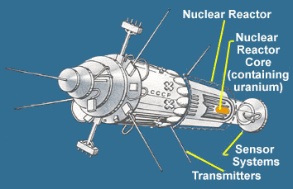
Secret Messages and Space – An Average Impression
Ask just about anyone what images come to mind with the two words ‘Secret Messages’ and ‘Space’ you’ll likely get something like:
Kosmos 854, the Soviet spy satellite that rained radioactive debris over northern Canada in 1978
Death from above scenarios like this scene from Real Genius

Slide 4
But Secret Messages Aren’t Just for Spies
Of course modern world is filled with the need for both:
Encoded messages
Encrypted messages
Applications abound
Banking, financial transaction, and bitcoin
Secure communications between servers
Handling hackers

Slide 5
Secret Messages and Encryption
Pin to lock your cell phone – why?
What happens when you don’t
Radical Edward

Slide 6
Top Secret

Slide 7


